Slide 1
Automated Software Testing
05. Web testing with Playwright

Slide 2

The student
Understands Key Concepts in Playwright:
  Define browser, browser context, page, and locators.
Masters Locators and Element Interaction
  Use different locator strategie to interact with elements.
Can Implement Assertions Using Locator Assertions
  Validate element states (visibility, text, enabled/disabled) using built-in assertions.
Can Develop and Run Test Scenarios in Playwright
  Design and execute automated test cases covering end-to-end user flows.

Slide 3

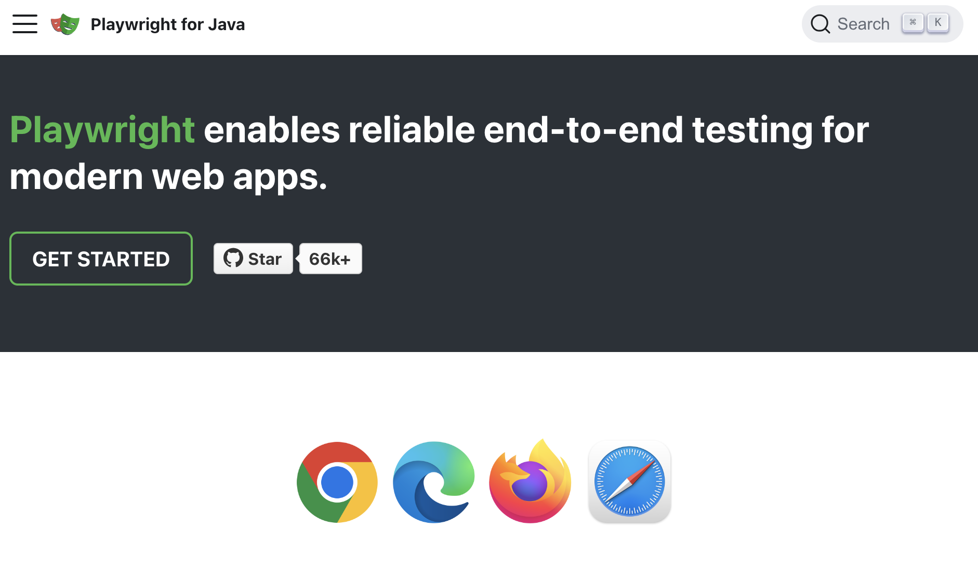
Playwright
https://playwright.dev/java/
Notes:
Playwright, an open-source end-to-end testing framework by Microsoft for testing your web applications. Playwright works with all modern browsers and on all platforms. Playwright can automate what a user does, such as clicking on elements and fill out forms. Playwright is as a really fast user. It wait for elements to be actionable before it clicks on them and retries when making assertions to make sure your tests are not flaky. Tests run in parallel by default.

Slide 4
Why Playwright?
Built to avoid flaky tests
  Auto-waiting: actions wait until the element is visible, stable and enabled.
  Retrying assertions: assertThat(locator) keeps checking until it passes or times out.
  Isolation: a fresh BrowserContext per test is fast and clean.
Batteries included: Chromium, Firefox and WebKit are downloaded for you; codegen, inspector, trace viewer and screenshots built in.
One API for Java, JavaScript/TypeScript, Python and .NET.

Slide 5
Same test: Selenium
driver.get(url + "catalog.html");
driver.findElement(By.cssSelector("[data-testid='filter-text']"))
.sendKeys("moon");
driver.findElement(By.cssSelector("[data-testid='filter-button']"))
.click();
new WebDriverWait(driver, Duration.ofSeconds(5)).until(
ExpectedConditions.numberOfElementsToBe(
By.cssSelector("tbody tr"), 1));
assertEquals("To the Moon and Back", driver
.findElement(By.cssSelector("[data-testid='event-name-2']")).getText());
You must add the explicit wait yourself: the table is re-rendered after the click.

Slide 6
Same test: Playwright
page.navigate(url + "catalog.html");
page.getByTestId("filter-text").fill("moon");
page.getByTestId("filter-button").click();
assertThat(page.locator("tbody tr")).hasCount(1);
assertThat(page.getByTestId("event-name-2"))
.hasText("To the Moon and Back");
No waits: locators and assertThat retry automatically. Fewer lines, less noise.

Slide 7
Playwright or Selenium?
Choose Playwright when
  you start a new project or test a modern web application.
  you want stable tests, fast feedback and strong debugging tools.
Selenium still makes sense when
  you maintain a large existing suite.
  you need real Safari, older browsers or real devices (cloud grids).
Be aware: Playwright WebKit is not real Safari.

Slide 8
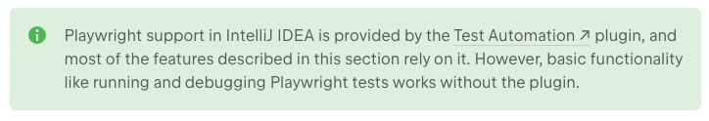
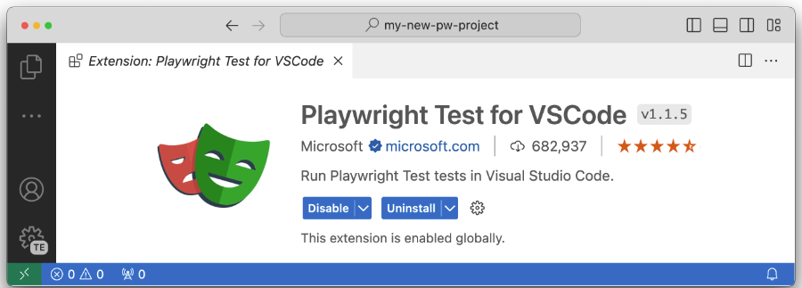
IDE

Slide 9

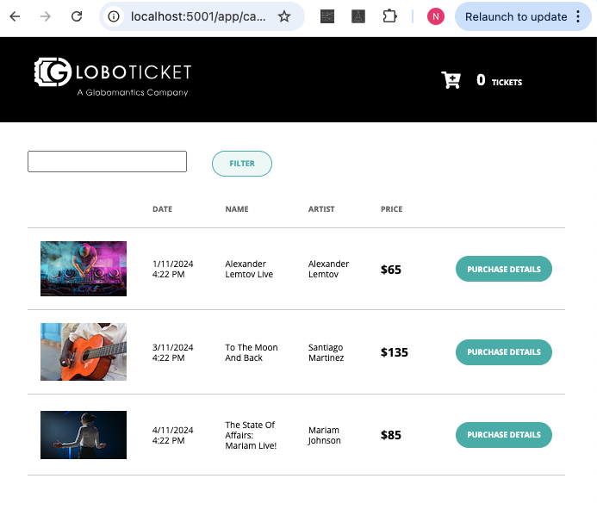
SUT
https://github.com/custersnele/playwright_introduction

Slide 10
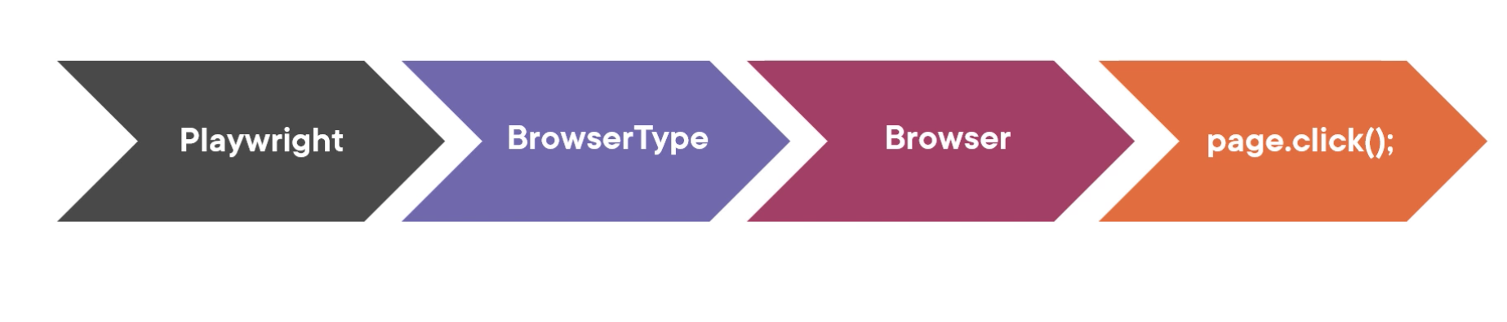
Core concepts

Slide 11
Playwright
try (Playwright playwright = Playwright.create()) {
...
}
the entry point for all Playwright operations.
try-with-resources - autocloseable

Slide 12
Browser
create browser instances using the playwright instance.
different BrowserTypes: Chromium, Firefox, or WebKit.
Browser browser = playwright.webkit().launch();
Browser browser = playwright.chromium().launch();
Browser browser = playwright.firefox().launch();

Slide 13
Browser
launch a browser in headless mode (default) or with a UI
BrowserType.LaunchOptions options = new
BrowserType.LaunchOptions().setHeadless(false);
browser = playwright.chromium().launch(options);
Notes:
The Browser object represents a real browser that Playwright interacts with. You can launch it in headless mode, which runs without a user interface, or with a UI for debugging purposes. Playwright supports Chromium (Chrome, Edge), Firefox, and WebKit (Safari). Each instance of the Browser allows you to create multiple browser contexts, which are independent environments within the same browser.

Slide 14
BrowserContext
Represents an isolated browser session (like a new incognito window).
Each BrowserContext is independent, meaning cookies, cache, and session storage do not leak between contexts.
You can have multiple browser contexts running in a single browser instance.
BrowserContext context = browser.newContext();

Slide 15
Page
Each BrowserContext can have multiple pages.
A Page refers to a single tab or a popup window within a browser context.
It is used to navigate to URLs and interact with the page content.
Page page = context.newPage(); page.navigate("https://example.com");

Slide 16
Benefits of multiple Browser Contexts and Pages
Faster Parallel Testing: Isolated contexts allow for parallel execution without interference.
Reduced Overhead: No need to launch a new browser instance for every test case.
Simulation of Multiple Users: Each context can simulate a different user session.
Browser
├── BrowserContext 1
│ ├── Page 1
│ └── Page 2
└── BrowserContext 2
└── Page 1

Slide 17
Maven dependencies
<dependency>
<groupId>com.microsoft.playwright</groupId>
<artifactId>playwright</artifactId>
<version>1.63.0</version>
<scope>test</scope>
</dependency>
<dependency>
<groupId>org.junit.jupiter</groupId>
<artifactId>junit-jupiter</artifactId>
<version>5.11.4</version>
<scope>test</scope>
</dependency>

Slide 18
First example
@Test
public void firstTest() {
try (Playwright pw = Playwright.create()) {
Browser browser = pw.chromium().launch();
Page page = browser.newPage();
page.navigate("http://localhost:5001/app/catalog.html");
System.out.println("Title: " + page.title());
}
}

Slide 19
Locators
Locators are the central piece of Playwright's auto-waiting and retry-ability. In a nutshell, locators represent a way to find element(s) on the page at any moment. A locator can be created with the page.locator() method.

Slide 20
Locators
These are the recommended built-in locators.
Page.getByRole() to locate by explicit and implicit accessibility attributes.
Page.getByText() to locate by text content.
Page.getByLabel() to locate a form control by associated label's text.
Page.getByPlaceholder() to locate an input by placeholder.
Page.getByAltText() to locate an element, usually image, by its text alternative.
Page.getByTitle() to locate an element by its title attribute.
Page.getByTestId() to locate an element based on its data-testid attribute (other attributes can be configured).

Slide 21
data-testid
A custom HTML attribute designed for easier targeting of elements in automated tests.
Invisible to end users but accessible to testing frameworks like Jest, Cypress, Selenium,...
Why?
  Test Stability: Avoids relying on CSS classes, IDs, or text that may change with UI updates.
  Separation of Concerns: Keeps test selectors separate from actual user-facing content.
  Improved Readability: Makes test code clearer by providing meaningful and consistent element selectors.
Notes:
In automated testing, one of the biggest challenges is writing robust and maintainable tests that don’t break when the user interface changes. Using data-testid attributes in code offers a clean and reliable way to select elements.
This approach decouples your test logic from changes in styling (CSS classes) or layout (DOM structure), making the tests more stable and easier to maintain over time. It also helps you avoid relying on text or labels, which might vary across different environments due to localization or content updates.
Encouraging developers to use data-testid ensures you always have dependable hooks for automation, even as the application evolves. Test scripts become more readable, and refactoring becomes less painful.

Slide 22
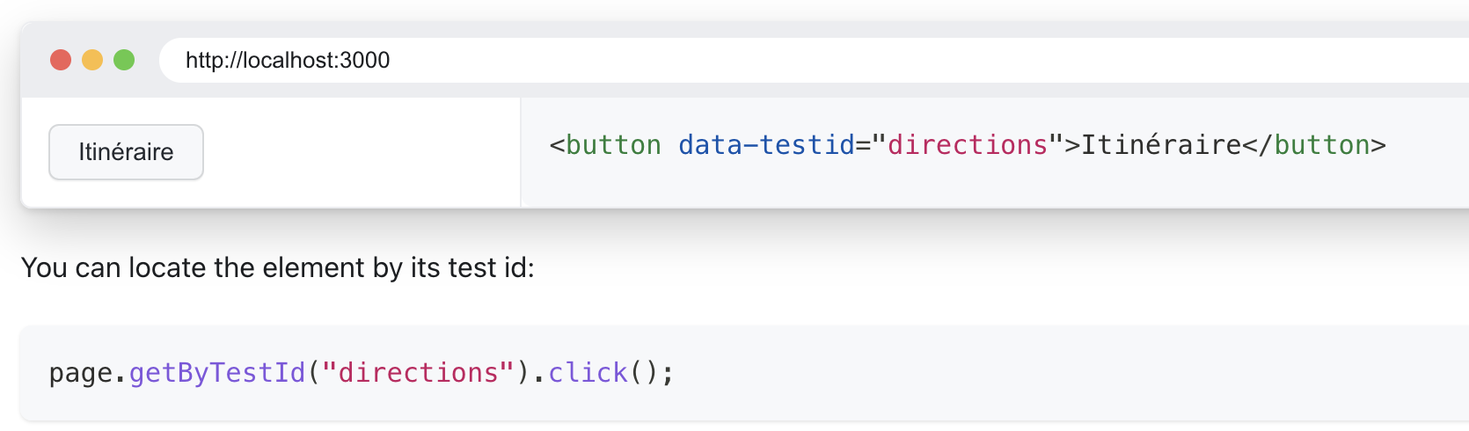
data-testid
Common Issues Without data-testid:
Flaky tests: Test scripts often break when UI elements like classes, IDs, or visible text are modified for styling or localization.
Complex selectors: Tests become hard to maintain when selectors rely on deep DOM structures or complex CSS classes.

Slide 23
Locators examples
page.getByLabel("User Name").fill("John");
page.getByLabel("Password").fill("secret-password");
page.getByRole(AriaRole.BUTTON, new Page.GetByRoleOptions().setName("Sign in"))
.click();
assertThat(page.getByText("Welcome, John!")).isVisible();
https://playwright.dev/java/docs/locators

Slide 24

Task 1
Write a playwright test to navigate to the http://localhost:5001/app/catalog.html page, and print out the inner text of all the elements with the class event-name.

Slide 25
Actions
Playwright can interact with HTML Input elements such as text inputs, checkboxes, radio buttons, select options, mouse clicks, type characters, keys and shortcuts as well as upload files and focus elements.
page.locator("a").first().click();
page.getByLabel("Birth date").fill("2020-02-02");
page.locator("input[type='checkbox']").check();
page.locator("select").selectOption("option-value");
https://playwright.dev/java/docs/input

Slide 26
LocatorAssertions
The LocatorAssertions class provides assertion methods that can be used to make assertions about the Locator state in the tests.
assertThat(page.title()).isEqualTo("Home");
assertThat(page.locator(".some-class").first()).isVisible();
assertThat(page.locator("p").first()).hasCSS("font-size", "16px");
https://playwright.dev/java/docs/test-assertions
https://playwright.dev/java/docs/api/class-locatorassertions

Slide 27
Auto-waiting and retrying assertions
Before every action Playwright checks the element is attached, visible, stable and enabled.
assertThat(locator) retries until it passes or times out (default 5 seconds).
Plain JUnit assertions do not retry: assertEquals(1, locator.count()) can fail for an element that shows up 100 ms later.
Prefer assertThat(...) over reading a value and asserting it yourself.
Avoid Thread.sleep and page.waitForTimeout.

Slide 28
Taking screenshots
When writing tests, you might want to take screenshots of the page at different points in the test.
This can be useful for debugging, or to visually verify that the page looks as expected. This is especially useful when running end-to-end tests in a CI/CD pipeline, to ensure that a webpage looks as expected.
Playwright allows you to take screenshots of the page, elements, or the browser window.
page.screenshot(new Page.ScreenshotOptions().setPath("screenshot.png"));

Slide 29
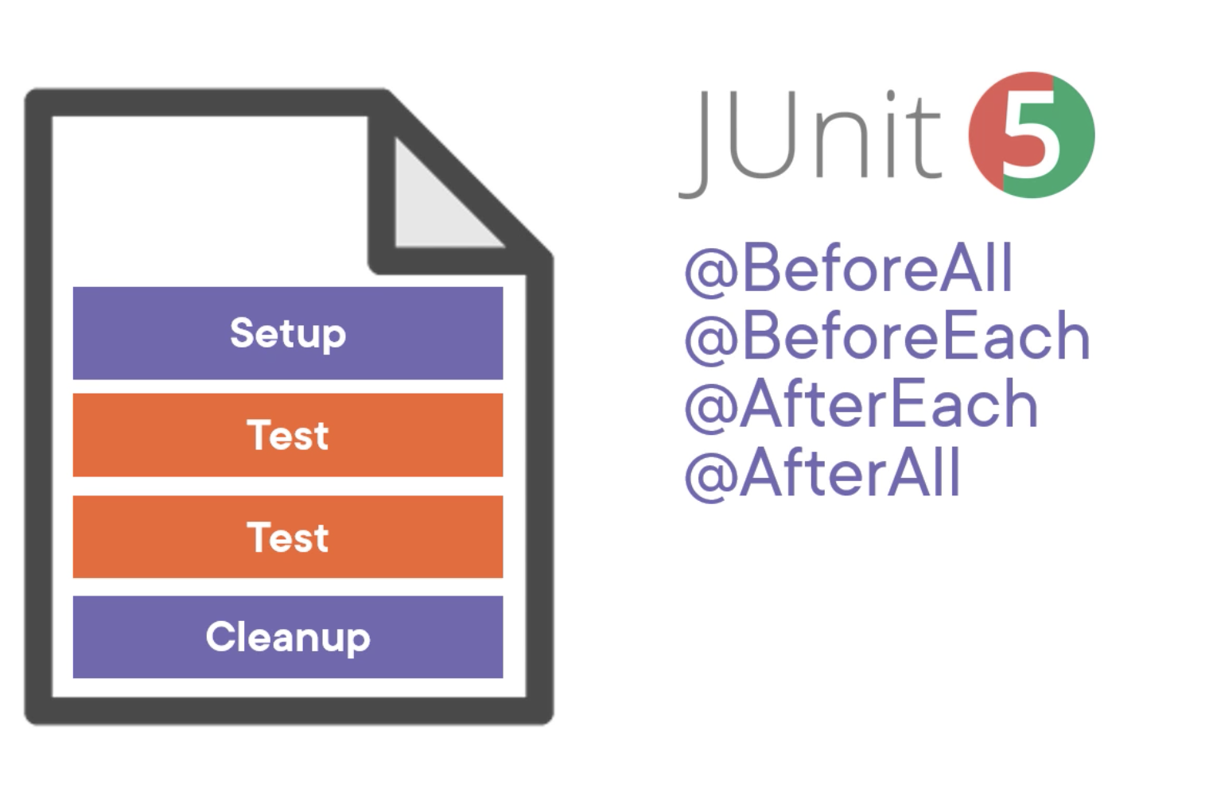
Test class layout

Slide 30
Generating tests
Playwright comes with the ability to generate tests out of the box and is a great way to quickly get started with testing.
It will open two windows, a browser window where you interact with the website you wish to test and the Playwright Inspector window where you can record your tests, copy the tests, clear your tests as well as change the language of your tests.

Slide 31
Debugging: inspector and trace viewer
Inspector: run with PWDEBUG=1, or add page.pause() to a test.
Trace viewer: record a trace and replay every step with DOM snapshot, network and console.
  context.tracing().start(new Tracing.StartOptions().setScreenshots(true).setSnapshots(true));
  context.tracing().stop(new Tracing.StopOptions().setPath(Paths.get("trace.zip")));
  mvn exec:java -e -D exec.mainClass=com.microsoft.playwright.CLI -D exec.args="show-trace trace.zip"

Slide 32
Task 2
Write a playwright test to navigate to the http://localhost:5001/app/catalog.html page,
Fill in the text “moon” in the filter field and click “Filter”
Verify there is only one event in the event-list.

Slide 33
Task 3
Write a playwright test to navigate to the http://localhost:5001/app/catalog.html page,
Click “Purchase details” for an event.
Verify the details page is displaying the right event name.
Change the quantity to “3” and click “Place order”
Verify the basket is showing the right quantity, total and number of tickets.

Slide 34
Task 4
Write a playwright test to navigate to the http://localhost:5001/app/catalog.html page,
Click “Purchase details” for an event.
Change the quantity to “3” and click “Place order”
Change the quantity to “4” and click update.
Verify the basket is showing the right total and number of tickets.

Slide 35
Task 5: bug hunt
Write a playwright test that filters the catalog on “Moon” (capital M) and verifies there is one event.
Run the test. It fails, but the same test with “moon” passes. Why?
Find the cause in web/app/js/main.js and describe the bug (expected vs actual behaviour).

Slide 36
Next week
Best practices
Using environment variables
Page object models

